Slide 1



Not Your Grandfather’s Corn Maze –
Regulatory and Legal Responses to Challenges Faced by Agriculture Due to PFAS Contamination

Slide 2
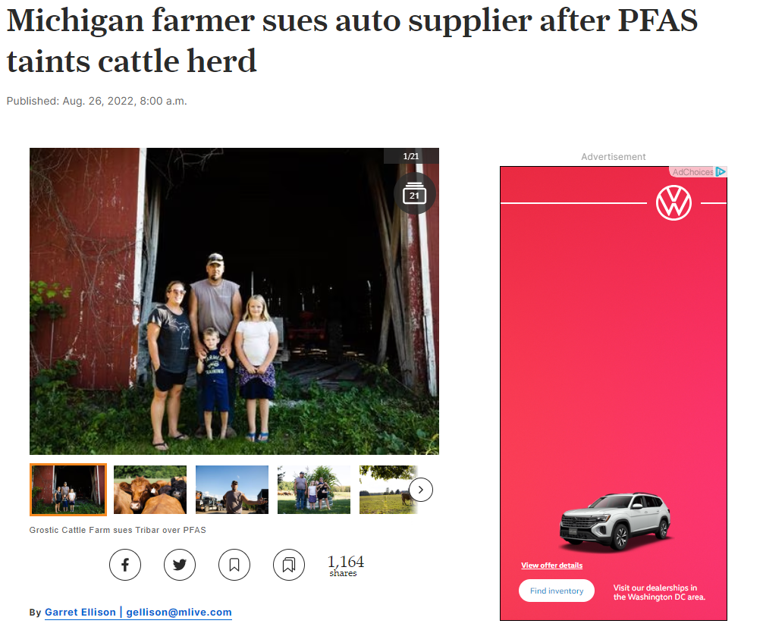
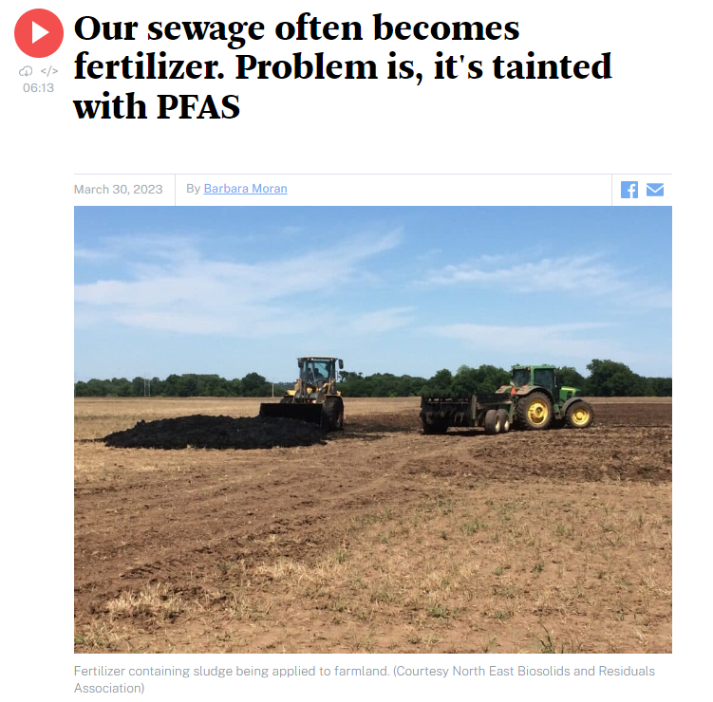
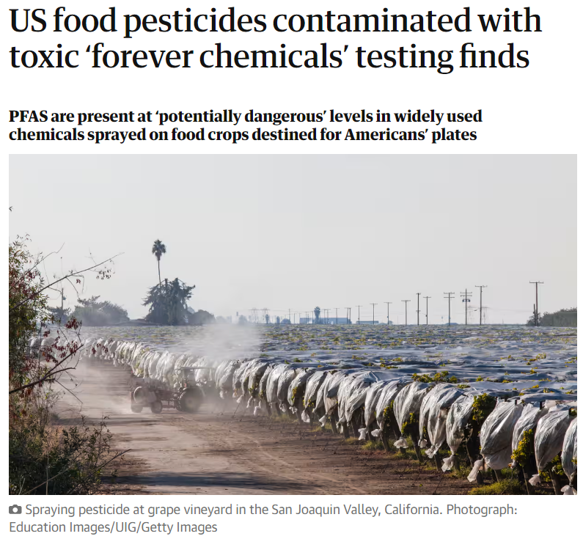
“
“
[W]astewater treatment plants like Deer Island were not built to handle the toxic “forever chemicals” known as PFAS.
The treatment process concentrates PFAS chemicals in the sludge, and therefore in the fertilizer.
Fertilizer made from Deer Island sludge would be allowed under Michigan’s specs but not Connecticut’s. Maine banned the use of sludge-based fertilizers altogether in 2022…Massachusetts has no guidelines, but regulators are “exploring options.”
Jason Grostic is feeding cattle that he can’t sell. He’s growing grain that nobody will buy. In his words, the farm is “slowly but surely going bankrupt.”
[T]he state of Michigan issued an advisory for beef from his organic farm after testing found elevated levels of toxic ‘forever chemicals’ known as PFAS in the meat they sell.
”
”
mlive. August 26, 2022.
“
I can’t imagine anything that could make these products any more dangerous than they already are, but apparently my imagination isn’t big enough,” said Nathan Donley, environmental health science director at the Center for Biological Diversity (CBD), which co-authored the study. “The EPA has to take control of this situation and remove pesticide products that are contaminated with these extremely dangerous, persistent chemicals.”
WBUR. March 20, 2023.
”
The Guardian. May 7, 2023.

Slide 3

Question One:
What are PFAS?

Slide 4
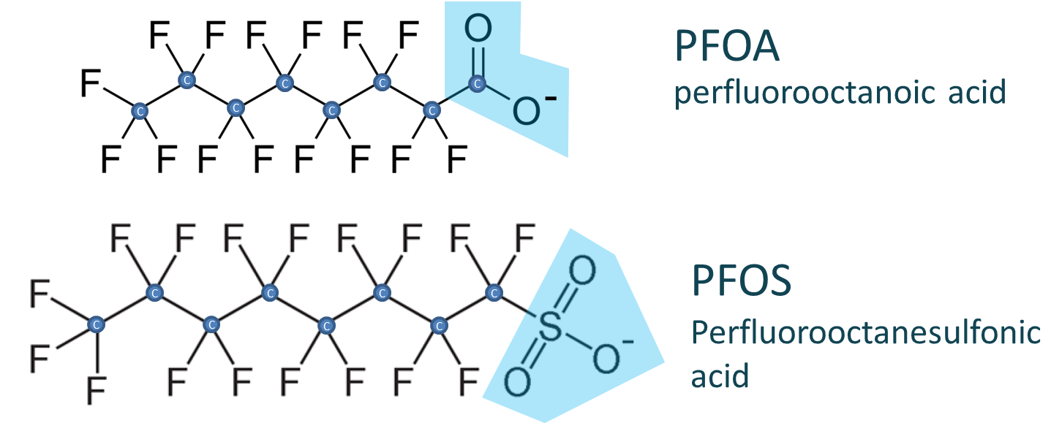
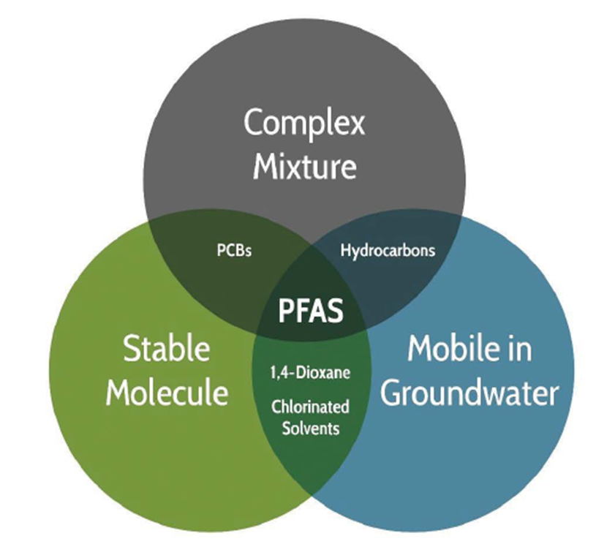
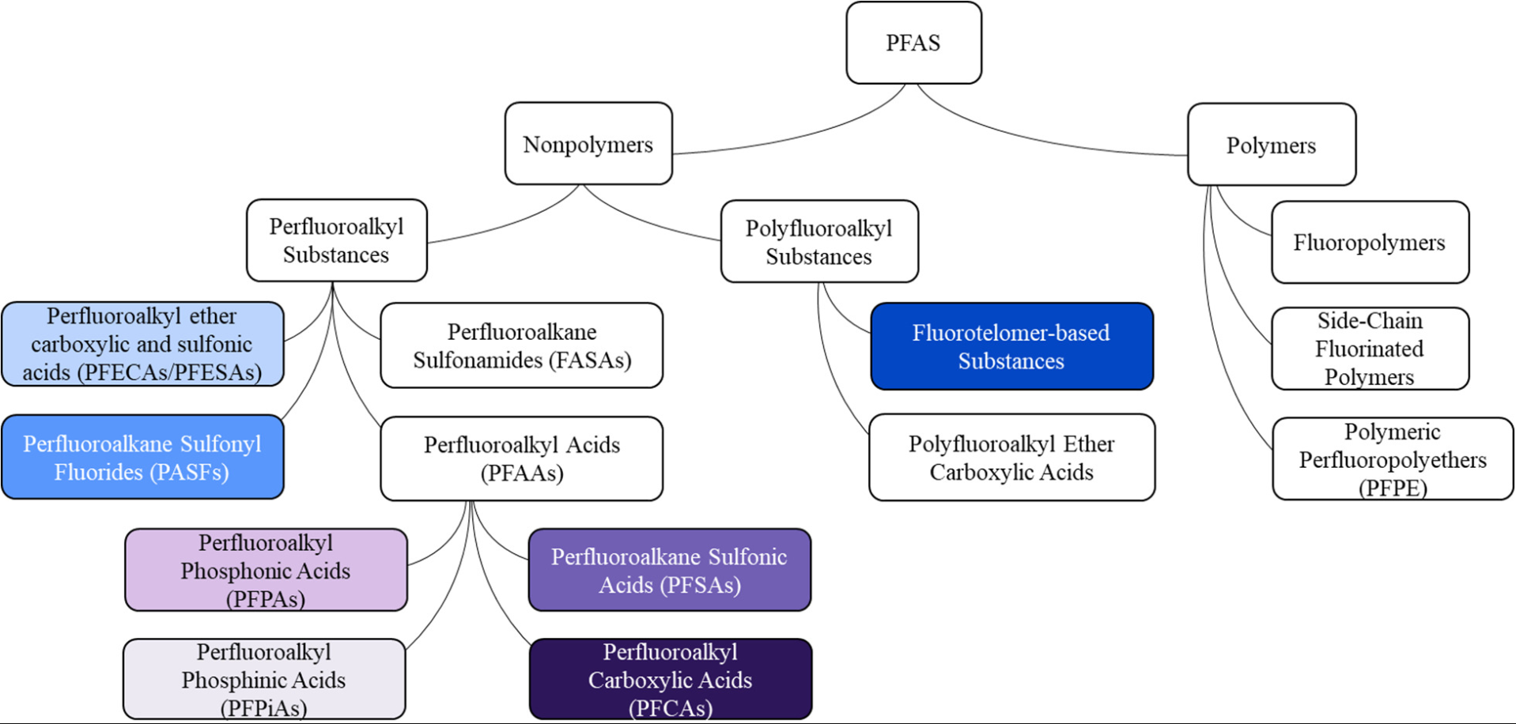
Characteristics
Class of compounds with strong, stable C-F bonds
Hydrophobic (water-hating) and AND lipophobic (oil-hating)
Relatively low volatility and high solubility
Mobile in the environment
Resistant to degradation
No natural environmental source
Regulated at VERY low levels (parts per trillion)

Slide 5
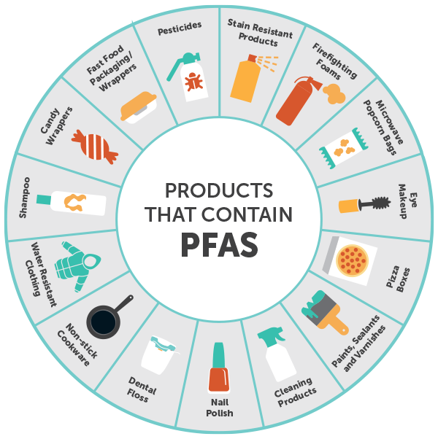
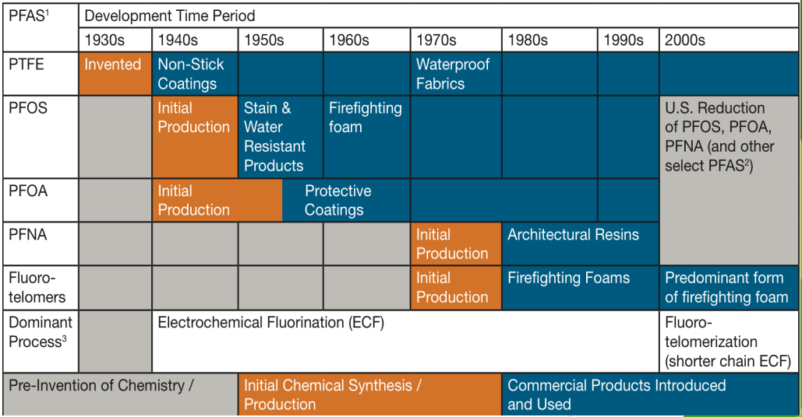
PFAS Industrial Uses
Wide range of industrial and commercial applications
Uses date back to the 1940s
Often in relatively small quantities
Proprietary formulations
Source: Pinellas County, Florida.

Slide 6
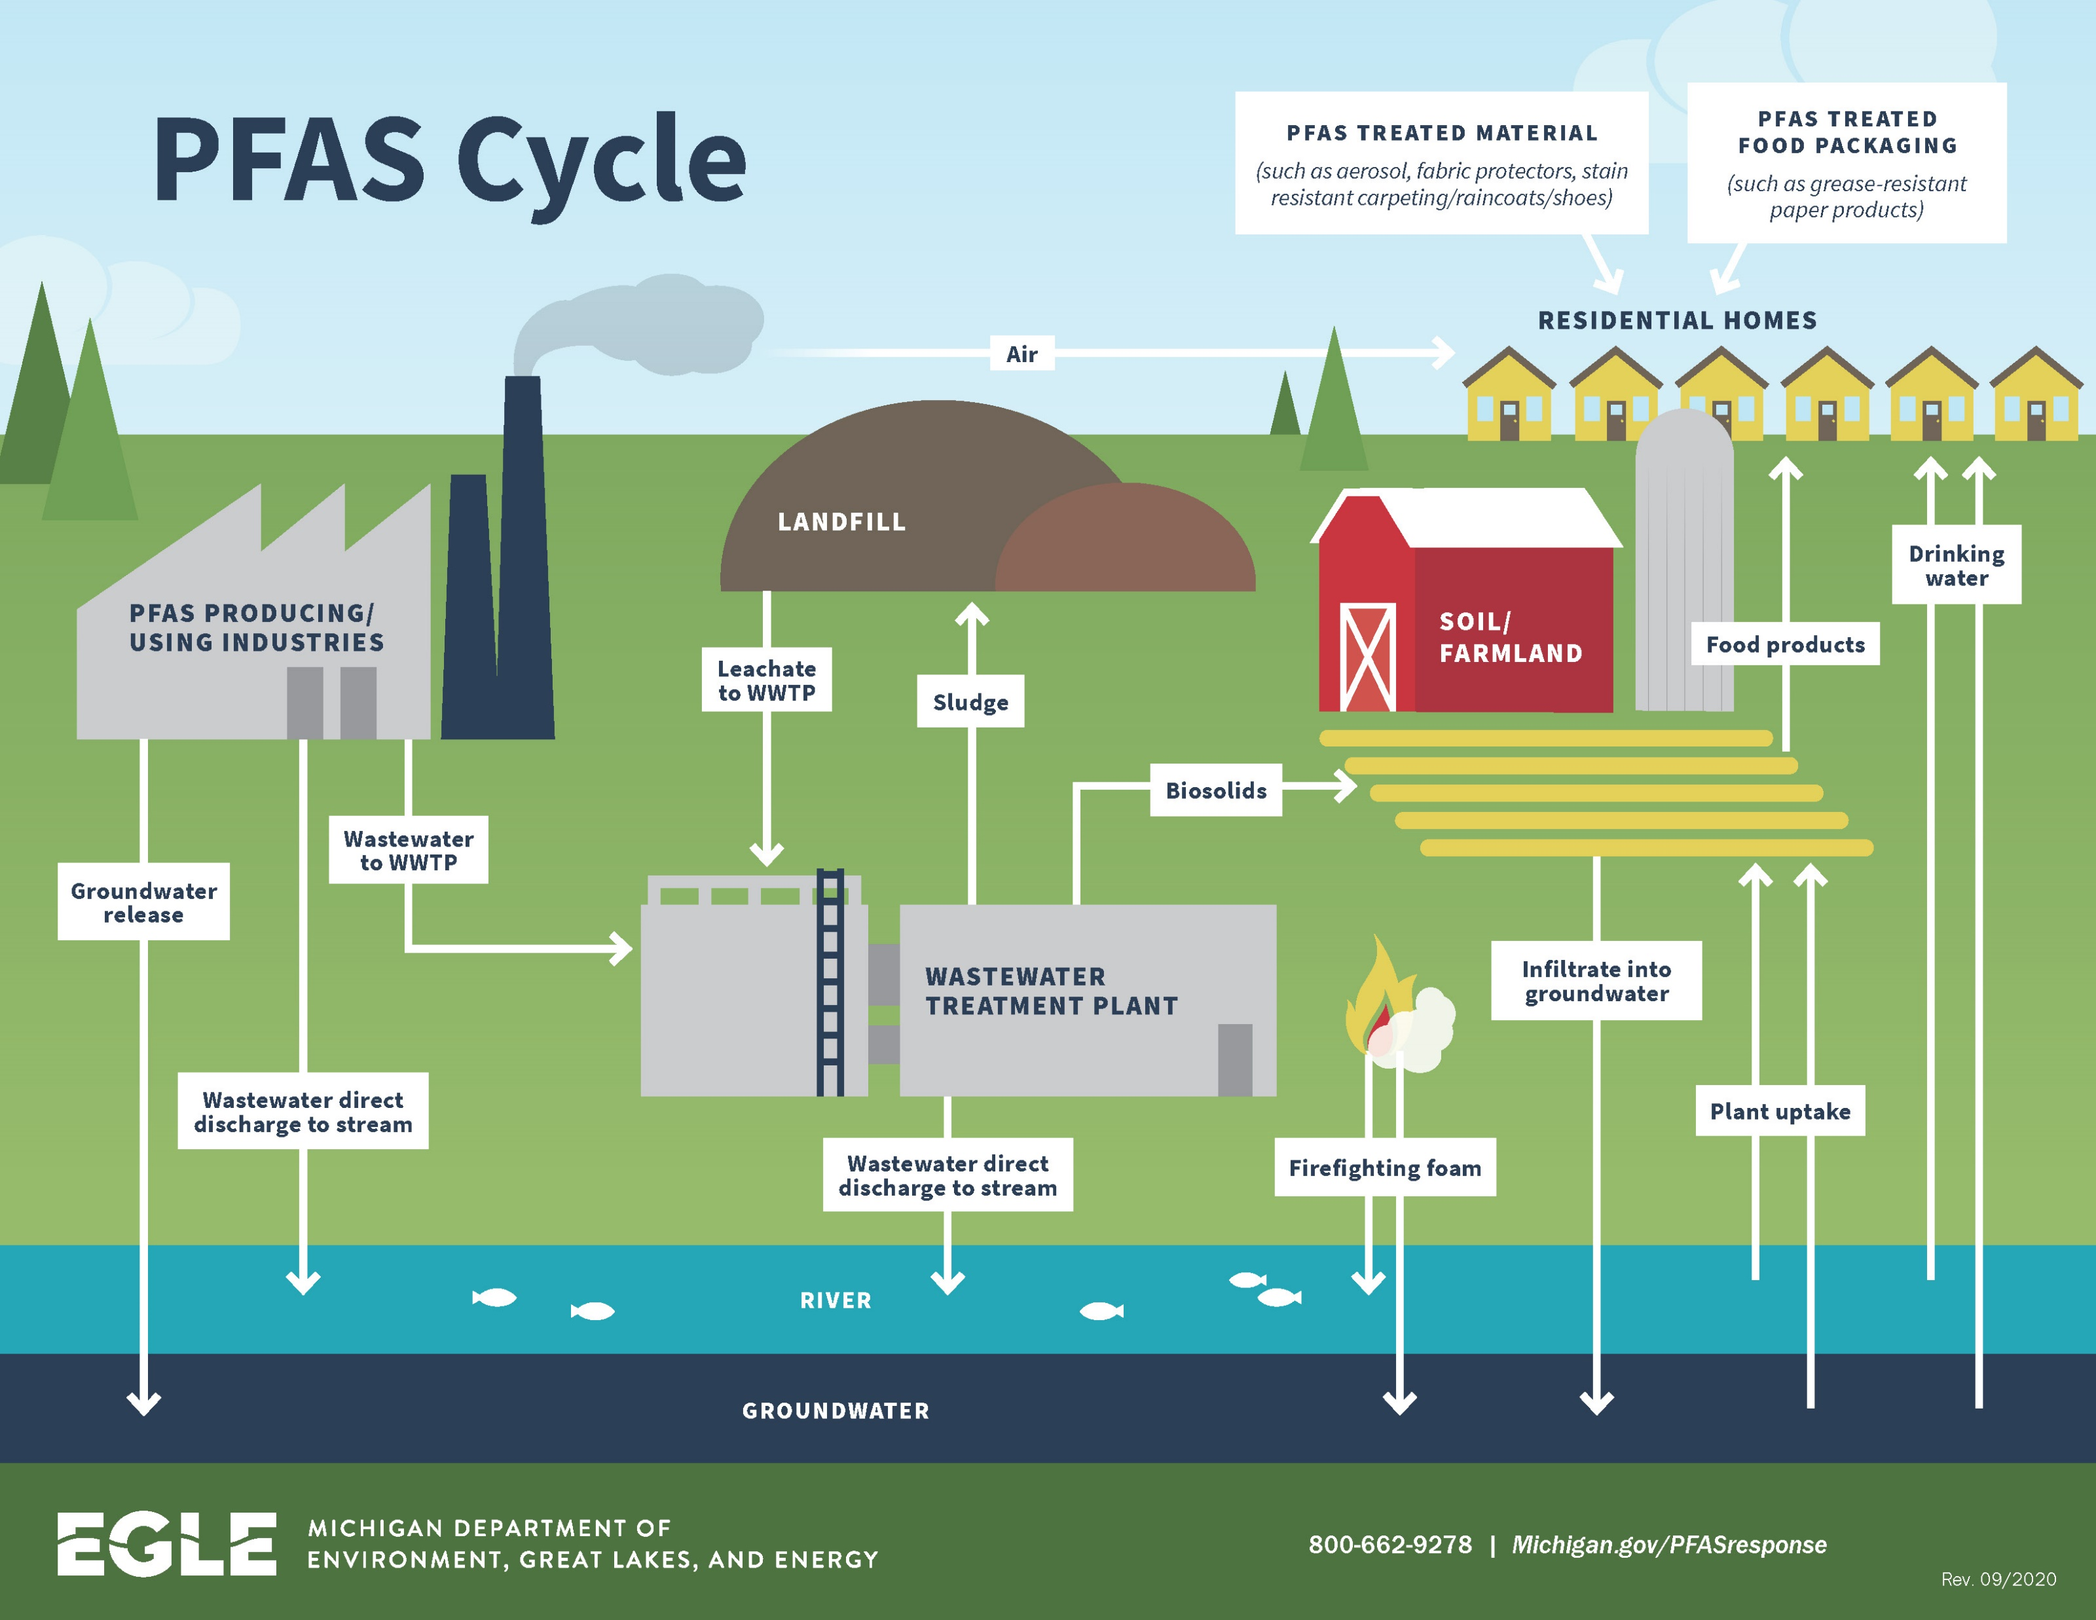
PFAS in Agricultural Products
Common Sources
Land-applied sewage sludge or biosolids
Industrial or municipal compost
Fire fighting foam
Irrigation water
Pesticides
Atmospheric Deposition
Costello, M.C.S., Lee, L.S. Sources, Fate, and Plant Uptake in Agricultural Systems of Per- and Polyfluoroalkyl Substances. Curr Pollution Rep (2020)
Michigan Department of Energy, Great Lakes, and the Environment.

Slide 7
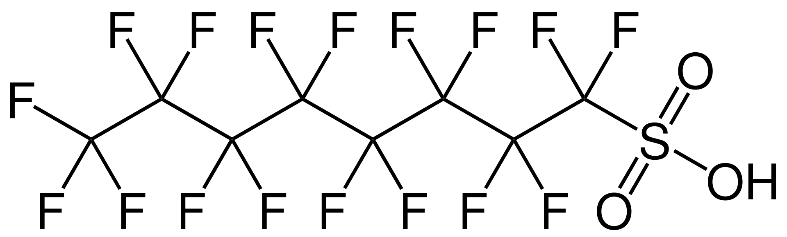
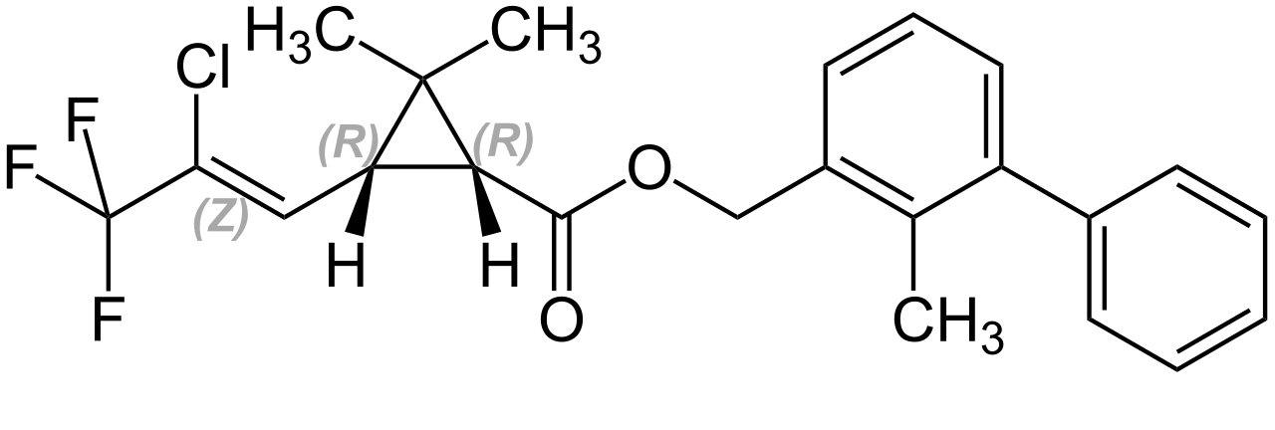
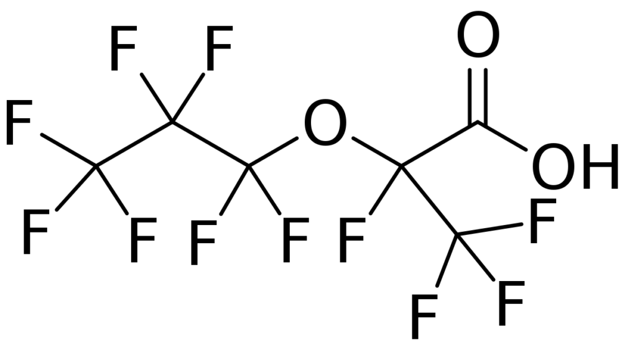
What is a PFAS Compound?
Perfluorooctanesulfonic acid (PFOS)
Bifenththrin
(Insecticide)
GenX Compounds

Slide 8
Question Two:
What is the significance of PFAS to the agriculture industry?

Slide 9

Significance for Agriculture and Food Processing Industries
Property Damage
Stranded Assets
Operating Expense
Indemnity Risk
Litigation Risk
Regulatory Compliance

Slide 10
Question Three:
What is the current regulatory and litigation environment for PFAS?

Slide 11
Disclaimer
When discussing the regualtory and litigation environment of PFAS, we will cover:
  What are current regulations covering PFAS.
  What are some of the ramifications of the new and proposed PFAS regulations.
  What litigation around PFAS are we seeing.
Disclaimer: This presentation does not constitute legal advice. I am not licensed to practice law in most states. Therefore, if there are additional PFAS issues or comments it may warrant engaging an attorney licensed to practice law in your particular state(s).

Slide 12
Federal Regulations
for PFAS

Slide 13
Environmental Protection Agency (EPA)
  March 2021: Regulatory Determinations for Contaminants on the Fourth Contaminant Candidate List.
    Includes final determination to regulate PFOA and PFOS in drinking water.
  October 2021: Published PFAS Strategic Roadmap—committing to:
    Bolder new policies to safeguard public health,
    Protect the environment, and
    Hold polluters accountable.
  November 2022: EPA released “A Year of Progress Under EPA’s PFAS Strategic Roadmap:”
    Underscores key actions taken by EPA during the first year of implementing the PFAS Roadmap.

Slide 14
EPA Cont’d
March 2023: Proposed PFAS National Primary Drinking Water Regulation (NPDWR) for six PFAS including:
    Perfluorooctanoic acid (PFOA), Perfluorooctane sulfonic acid (PFOS), Perfluorononanoic acid (PFNA), hexafluoropropylene oxide dimer acid (HFPO-DA, commonly known as GenX Chemicals), Perfluorohexane sulfonic acid (PFHxS), and Perfluorobutane sulfonic acid (PFBS).
    Proposed PFAS NPDWR does not require any actions until it is finalized.
    If fully implemented, expected to prevent thousands of deaths and reduce tens of thousands of serious PFAS-attributable illnesses.
2023: Regional Listening Sessions: EPA has already held over 10 virtual regional listening sessions in 2023.
    Includes a session focused on each EPA Region and a specific session for Tribal partners.

Slide 15
EPA Cont’d
Advance Notice of Proposed Rulemaking (ANPRM)
September 2022: Seeking public input/data to consider future regulations on PFAS under the Comprehensive Environmental Response, Compensation, and Liability Act (CERCLA/Superfund).
    Seeking input and data regarding potential future hazardous substance designation under CERCLA.
    If officially listed as hazardous substances:
        EPA will have new authority to hold “potentially responsible parties” liable for cleanup of certain PFAS released into the environment.
        Private parties would be able to bring cost recovery or contribution claims under CERCLA.
April 13, 2023: ANPRM sought input on which additional PFAS compounds should be added as hazardous substances.

Slide 16

Food and Drug Administration (FDA)
Assessing dietary exposure to PFAS.
Publishes Analytical Results.
Enforcement (since 2019):
    FDA enforces PFAS in food based on health hazard analysis – EPA’s Toxic Reference Values (TRVs) (low-level) & National Health and Nutrition Examination Survey (NHANES) consumption data.
        Nearly 800 samples of food in U.S. market:
            Seafood,
            Infant formula,
            Lettuce,
            Milk,
            Bread,
            Cheese, and
            Etc.…

Slide 17
Food and Drug Administration (FDA)
21 CFR (FDA) – Food Contact Materials
    PFAS are regulated by FDA in food contact products.
    Only PFAS authorized by FDA can be used in food contact materials.
    Currently, FDA does not set maximum allowed limits on PFAS in food contact products.
PFAS authorized for contact with food generally in four categories:
    Non-stick cookware,
    Gaskets, O-Rings, other parts used in food processing equipment
    Processing aids, and
    Paper/paperboard food packaging.
No specific Federal regulation around PFAS in food packaging → leaving it to the states…

Slide 18
State Regulations
for PFAS

Slide 19
Patchwork State System
There are currently 197 policies in 33 states pending bills.
There are 131 adopted policies in 25 states.
States differ in the language included in their policies:
    “Intentionally added,”
    “Food” and “Food products,”
    Timeline, and
    Etc.….
Will states policies/regulations be preempted?...

Slide 20
Expected Litigation Trends Around PFAS
More to come…
Currently focused on PFAS (PFOA & PFOS) manufacturers and purchasers of PFAS.
Will likely expand to those who produce products in areas with PFAS contamination (water, social, etc.) and those who buy/sell products with PFAS (especially “intentionally added”).
  This will putting new companies and new industries in the spotlight.

Slide 21
Takeaways & Questions
Kyla Kaplan
kkaplan@ofwlaw.com
Chase Gerbig
cgerbig@rouxinc.com
Ryan Stifter
rstifter@rouxinc.com

