Slide 1

Foreign Ownership of Land: 2023 Legislative Review
Micah Brown, Staff Attorney (Ag Finance & Credit)
National Agricultural Law Center

Slide 2
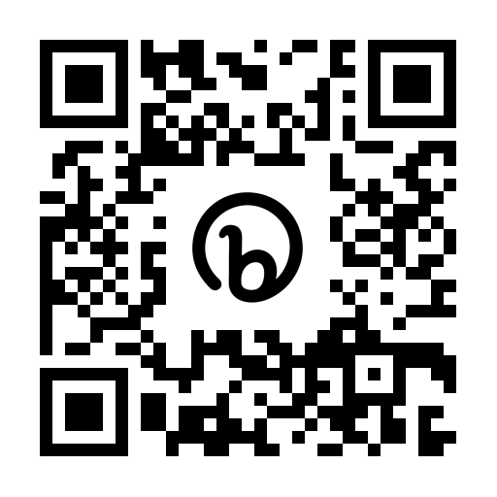

About the Center
The National Agricultural Law Center is the nation’s leading source for agricultural and food law research and information.
We provide objective, non-partisan research and information regarding laws and regulations affecting agriculture.
The Feed is a brief, bi-monthly rundown of ag law and policy developments from around the country, including foreign ownership proposals.
Subscribe to The Feed using QR Code

Slide 3
Foreign Ownership in U.S. Farmland
Agricultural Foreign Investment Disclosure Act (“AFIDA”) of 1978
Latest official data is through December 31, 2021
  Foreign ownership in private ag land: 40,031,308 (3.1% of all private ag land)
    +2.4 million acres from Dec. 31, 2020
    14.3+ million-acre increase (+35.7%) from 2011 to 2021
  47% forestland
  29% cropland
  22% pasture/other ag purposes

Slide 4
Foreign Ownership in U.S. Farmland
Top countries of foreign investments?
  Canada (31%)
  Netherlands (12%)
  Italy (7%)
  United Kingdom & Germany (6%)
China reports 0.9% ownership interest in ag and non-ag land
States with most foreign held ag land acres?
  Texas (5.2 million)
  Maine (3.6 million)
  Colorado (1.9 million)
  Alabama (1.8 million)
  Oklahoma (1.67 million)
  Washington (1.58 million)

Slide 5
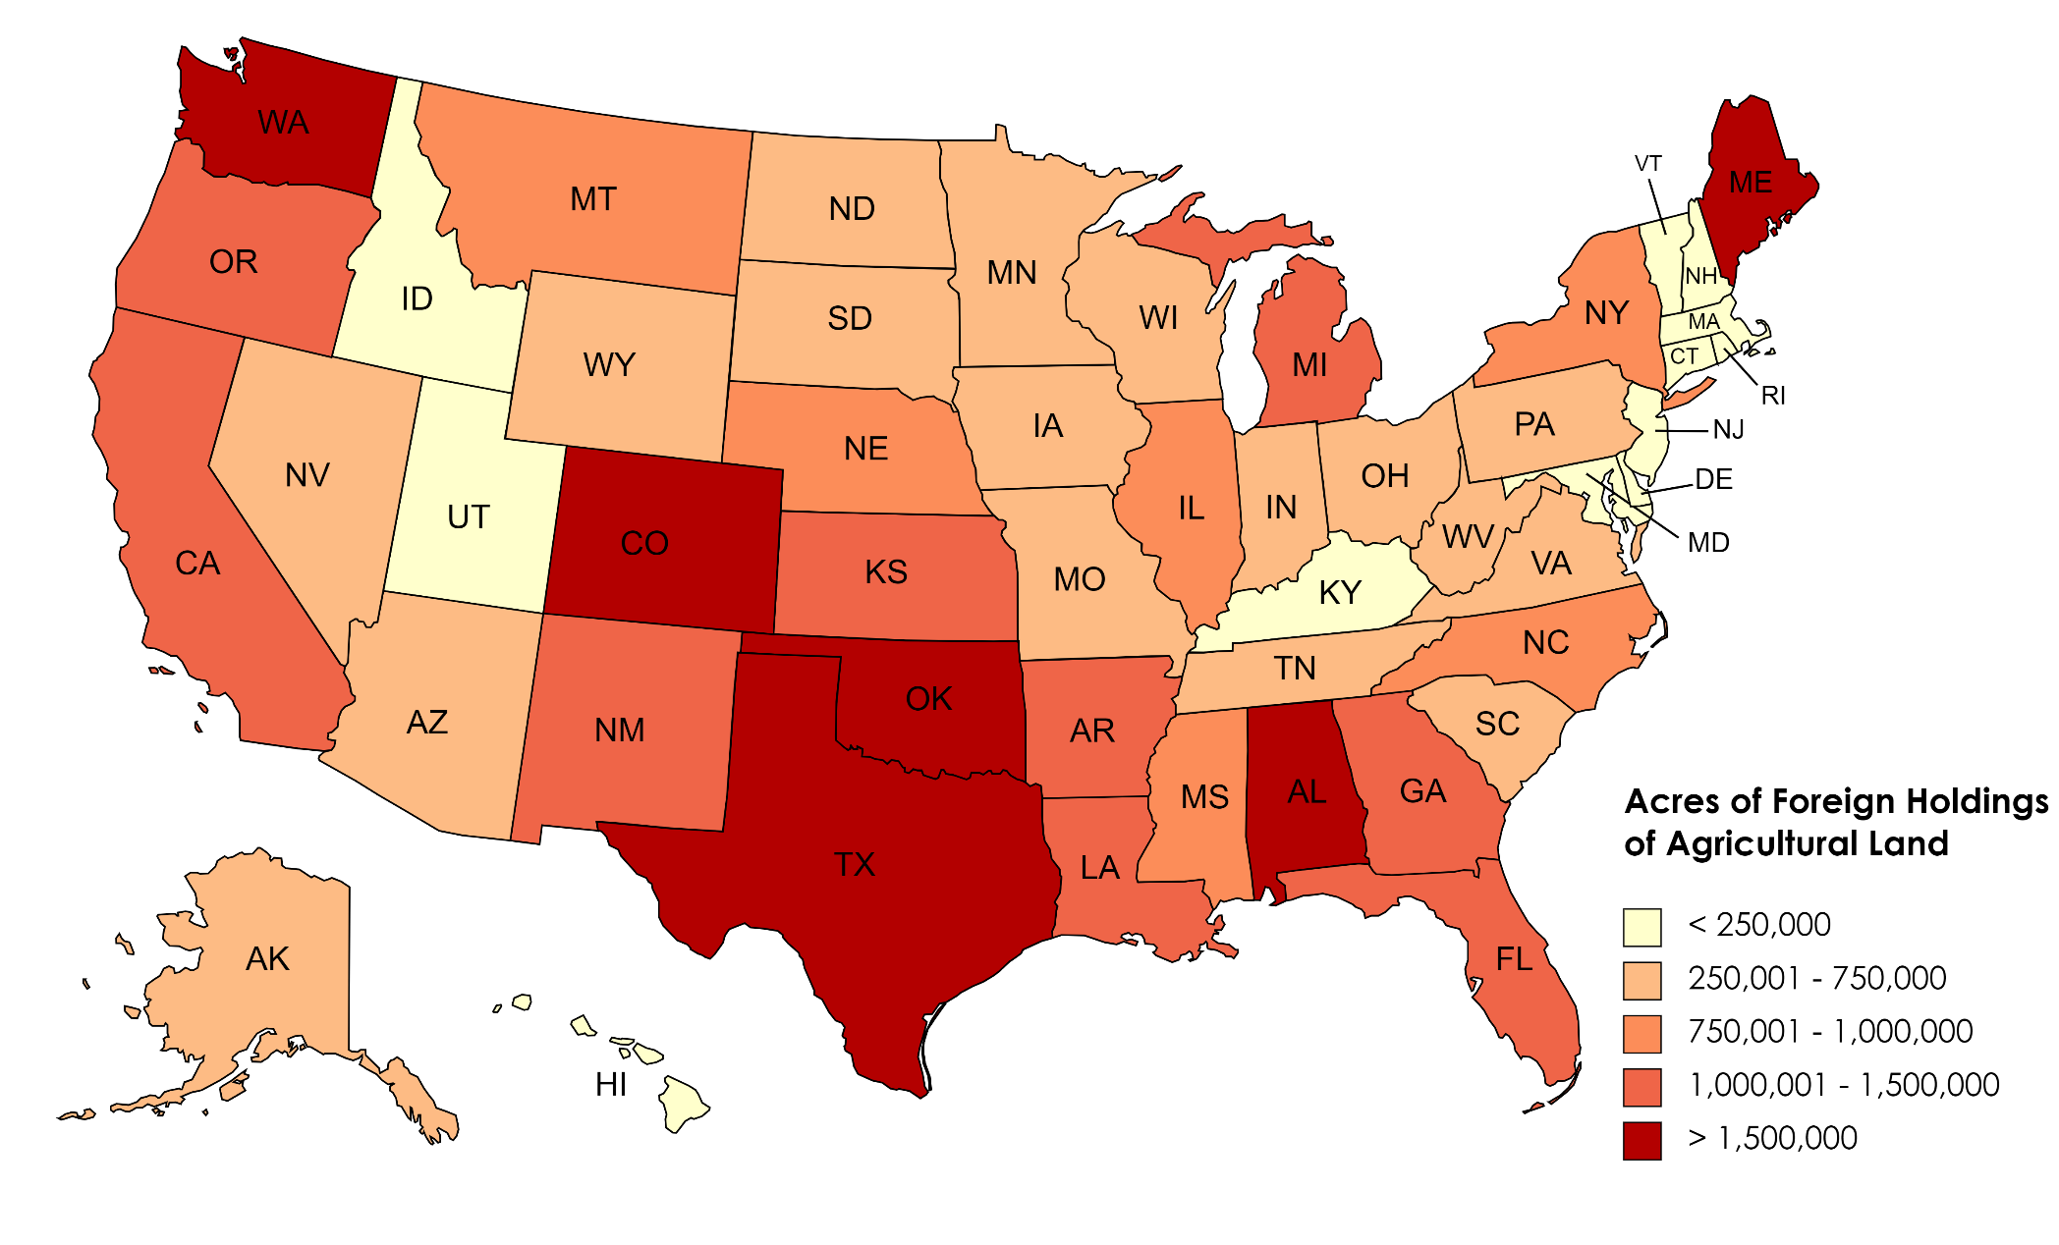
Foreign Ownership of U.S. Farmland

Slide 6
Federal Proposals
118th Congress has considered several measures that seek to control, prohibit, restrict, or increase oversight on foreign investments in U.S. agriculture
Categories:
  Restrict Chinese investments in U.S. agricultural land
  Restrict multiple foreign countries from investing in U.S. agricultural land
  Restrict investments in all U.S. real property
  Restrict through other methods
  Amend AFIDA
  Prevent foreign participation in farm programs
  Adding USDA as a member of CFIUS

Slide 7
Restricting Chinese Investments in Ag Land
Lower Energy Costs Act (H.R. 1)
  House adopted amendment to prohibit CCP, its agents, and gov’t-owned entities from acquiring “any interest” in ag land (and land to produce renewable energy)
Prohibition of Agricultural Land for the People’s Republic of China Act (H.R. 809)
  “President shall take actions…to prohibit the purchase of public or private agricultural (including ranching) real estate…by nonresident aliens, foreign businesses, an agent, trustee, or fiduciary associated with the Government of the People’s Republic of China.”
This Land Is Our Land Act (S. 684)
  Restricts individuals, entities, and gov’t of China from acquiring/leasing ag land
  Chinese ag land owned before effective date → must divest within 2 years
  Fine of $100 per acre per day
  Forfeiture (public sale); imprisonment up to 5 years
  Enforced by AG

Slide 8
Restricting Multiple Countries Investments in Ag Land
National Defense Authorization Act for Fiscal Year 2024 (S.Amdt.813)
  Originally introduced as the Promoting Agriculture Safeguards and Security Act (“PASS Act”) (S. 168/H.R. 683)
  CFIUS determines a transaction would result in control by a “covered foreign person” of ag land (>320 acres or $5 million) or ag business, president must prohibit transaction
    “Covered foreign person” includes an individual, entity, and gov’t of the China, Iran, North Korea, or Russia (“Big 4”)
  President may waive this requirement waiver is vital to U.S. national security
Protecting America’s Agricultural Land from Foreign Harm Act of 2023 (S. 926/ H.R. 3357)
  Directs president to prohibit the purchase/lease of public or private ag land by individual, entity, or gov’t of the Big 4
  Fine of $250K or 2x amount of transaction
  Criminal fine up to $1 million and/or up to 20 years in prison

Slide 9
Restricting Multiple Countries Investments in Ag Land
Farmland for Farmers Act (S. 2583)
  Establishes corporate farming law
  Restricts U.S./foreign entities from participating in agriculture/acquiring ag land
    Exempts research and experimentation
    Grandfather clause
  If USDA determines a violation occurs, reports to AG
  If violation, must divest w/in 1 year
    If not, civil penalty 2x FMV of ag land and up to 5 years imprisonment
  Authorizes state AGs to bring action
Agriculture appropriations for FY24 (H.R. 4368)
  Directs USDA to prohibit the purchase of ag land by foreign (nonresident) individuals and foreign businesses associated with the Big 4

Slide 10
Restricting Investments in Real Property
Protecting our Land Act (H.R. 212)
  “President shall direct…Federal departments and agencies to promulgate rules and regulations to prohibit the purchase of public or private real estate…by a foreign adversary, a state sponsor of terrorism….”
  “Foreign adversary” includes foreign governments and “nongovernment persons” engaged in conduct adverse to U.S. national security
Securing America’s Land from Foreign Interference Act (H.R. 344)
  President must prohibit members of and entities owned/controlled by the CCP from acquiring any public/private real property
Saving American Farms for Adversaries Act (H.R. 840)
  President has 5 years to prohibit “any foreign person” from purchasing public or private real property
  Directs GAO to report to Congress on foreign purchases of U.S. land

Slide 11
Restricting Investments in Real Property
Protection of American Land Act of 2023 (H.R. 4806)
  Prohibit a “foreign national” from owning or purchasing land
  “Foreign nation” includes foreign gov’t, gov’t-owned entity, and gov’t officials
  Requires foreign nation to return land to U.S. gov’t → U.S. gov’t pays market-rate compensation
Not One More Inch or Acre Act (S. 1136)
  President must prohibit individuals, entities, and the gov’t of China from purchasing public/private real property
  Directs president to require the sale of real estate owned by China or Chinese investors if the ownership poses a risk to national security
  Does not apply to: (1) U.S. citizens; (2) lawful permanent residents; (3) refugees; and (4) person granted asylum

Slide 12
Restricting Through Other Methods
Stop China’s Continuous Purchase of Land Act (H.R. 4772)
  States are ineligible to receive funds from certain federal programs if the state does not have a FOL restricting certain countries (includes Big 4)
Protecting American Farmland Act (H.R. 3996)
  Introduced under the Build It in America Act (H.R. 3938) which is part of the tax package under the “American Families and Jobs Act”
  Imposes 60% tax on amount paid for farmland by Big 4 + Cuba/Venezuela

Slide 13
Amending AFIDA
Protecting America’s Agricultural Land from Foreign Harm Act of 2023 (S. 926)
  Require USDA to publish all data it receives through FSA-153s
  Disclose foreign persons who hold at least 1% interest in ag land
  Update database w/in 30 days of receiving FSA-153
Security and Oversight for International Landholdings Act of 2023) (“SOIL Act”) (H.R. 1066)
  Decreases reporting requirement for leases 5+ years
  Directs USDA to identify countries that own/lease water rights in the U.S.
Not One More Inch or Acre Act (S. 1136)
  Increases base penalty to 10% of FMV
H.R. 1789
  Increases base penalty to 50% of FMV

Slide 14
Amending AFIDA
Foreign Agricultural Restrictions to Maintain Local Agriculture and National Defense Act of 2023) (“FARMLAND Act”) (S. 2060)
  Directs USDA to conduct investigations into efforts to steal ag technology and knowledge to disrupt the U.S. ag base
  Directs USDA to conduct an annual audit of FSA-153s for compliance
Farmland Security Act of 2023 (S. 2382)
  AFIDA violations by shell corporations penalized at 100% FMV
  Directs USDA to annually audit at least 10% of the FSA-153s received that year

Slide 15
Restricting Farm Program Participation
Protecting America’s Agricultural Land from Foreign Harm Act of 2023 (S. 926/ H.R. 3357)
  Ag land owned/leased by an individual, entity, or gov’t of the Big 4 are ineligible for USDA-administered programs
  Exempts: (1) food inspection/safety regulatory requirements; (2) health/labor safety requirements; and (3) participation in AFIDA
FARMLAND Act (S. 2060)
  Prohibits ag land owned/operated by “foreign person” from participating
  Participant must certify they are not a foreign person
  Penalty for violation can be up to 125% of benefits received from program participation
SOIL Act (S. 1066)
  No federal assistance for certain foreign ag landholdings

Slide 16
Adding Agriculture to CFIUS
Foreign Adversary Risk Management Act (“FARM Act”) (S. 68/H.R. 513)
  Adds ag systems and supply chains within the meaning of “critical infrastructure” and “critical technologies”
  Authorizes CFIUS to review transactions that would result in foreign control of any U.S. ag business
Protecting U.S. Farmland and Sensitive Sites From Foreign Adversaries Act (H.R. 4577)
  Adds USDA as a member of CFIUS to review transactions related to the ag industry (purchase of ag land and ag biotechnology)
SOIL Act (S. 1066)
  Directs CFIUS to review ag land purchases by person of either (i) a nonmarket economy country, or (ii) countries identified as posing a risk to national security under the most recent “Annual Threat Assessment”

Slide 17
Adding Agriculture to CFIUS
FARMLAND Act (S. 2060)
  Requires CFIUS to review foreign entities’ land purchases/leases exceeding $5 million or 320 acres of land over the past 3 years
National Defense Authorization Act for Fiscal Year 2024 (S. 2226)
  If CFIUS determines a transaction would result in control by an investor of the Big 4 in ag land or ag business, president must prohibit the transaction
  President may waive this requirement to prohibit a transaction if it is vital to U.S. national security to waive the prohibition
Food Security is National Security Act of 2023 (S. 2312)
  Authorizes CFIUS to review transactions that have a potential impact on U.S. food security and ag systems

Slide 18
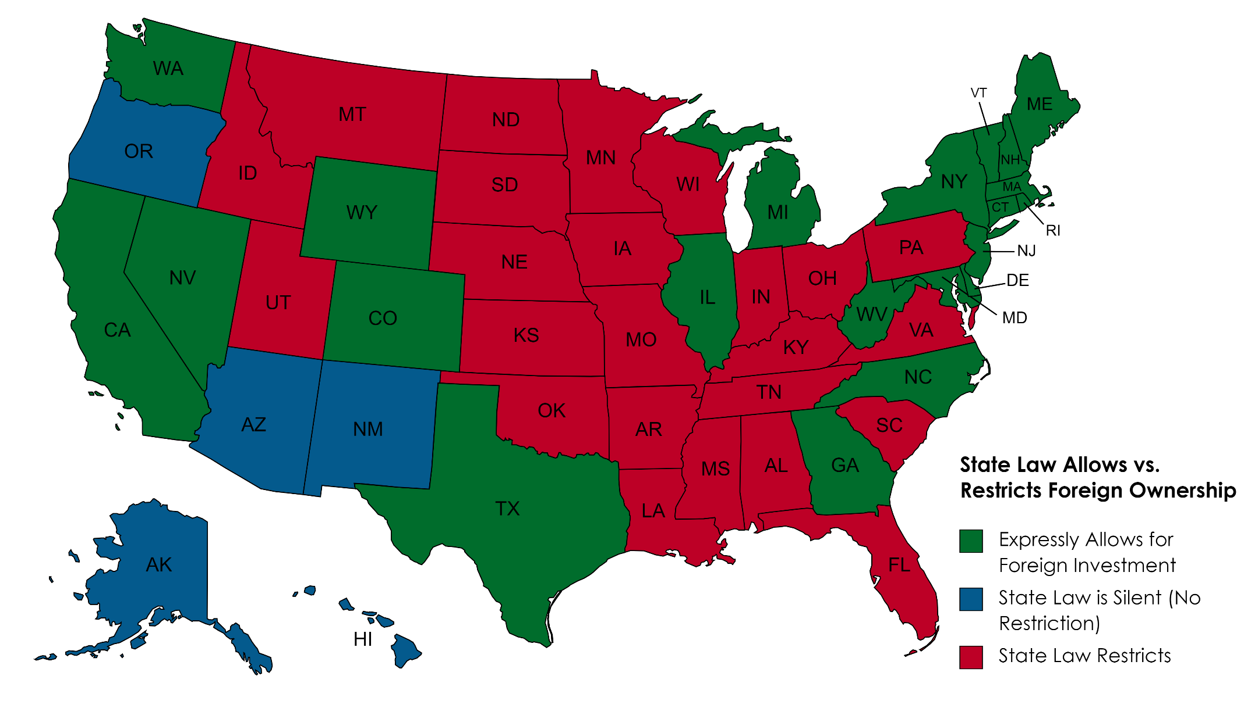
State Law Allows vs. Restricts Foreign Ownership

Slide 19
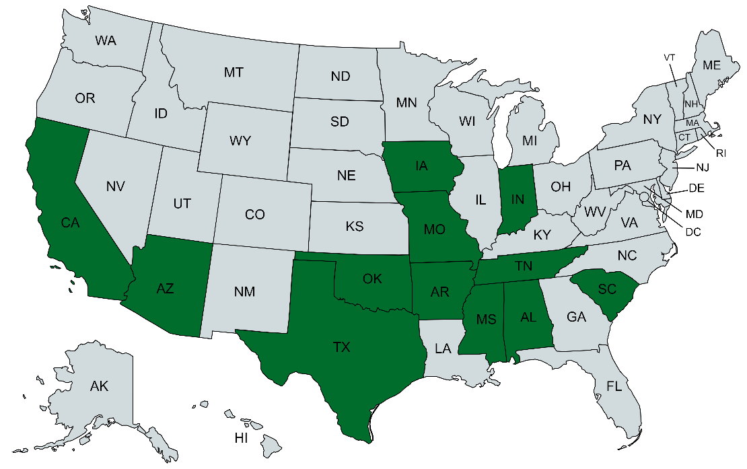
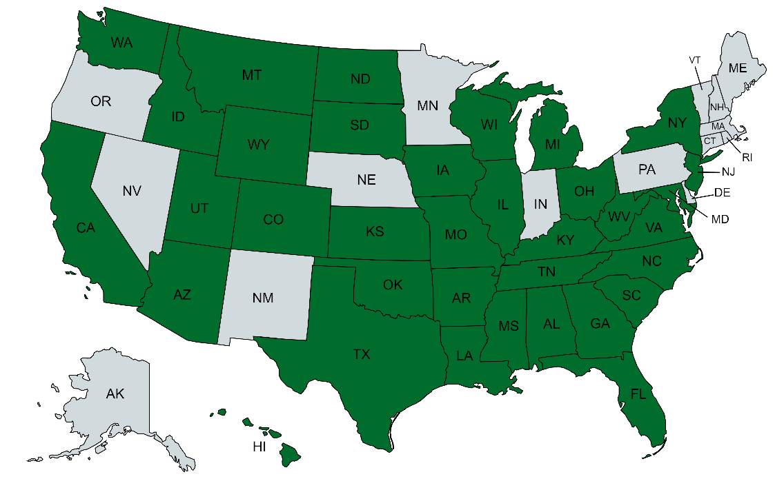
State Foreign Ownership Proposals
2021–2022
2023

Slide 20
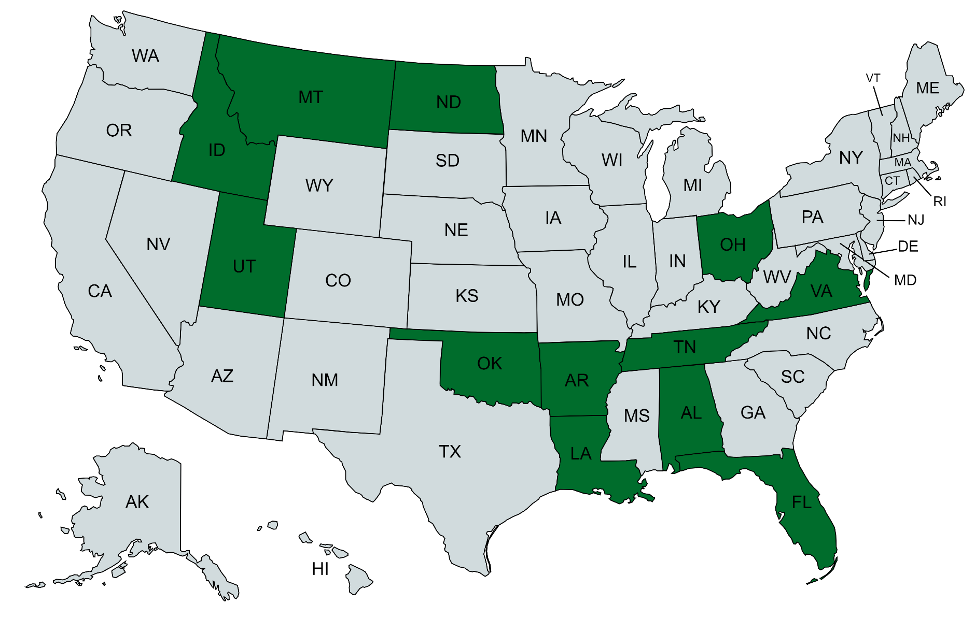
2023 Foreign Ownership Laws: Enacted

Slide 21
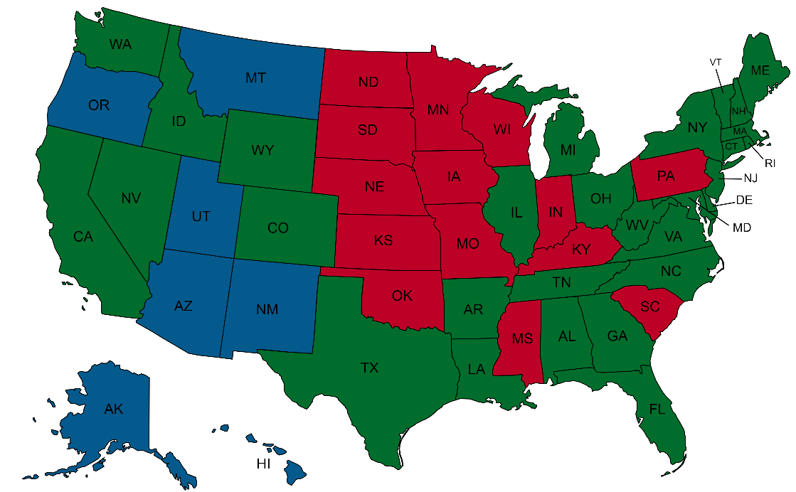
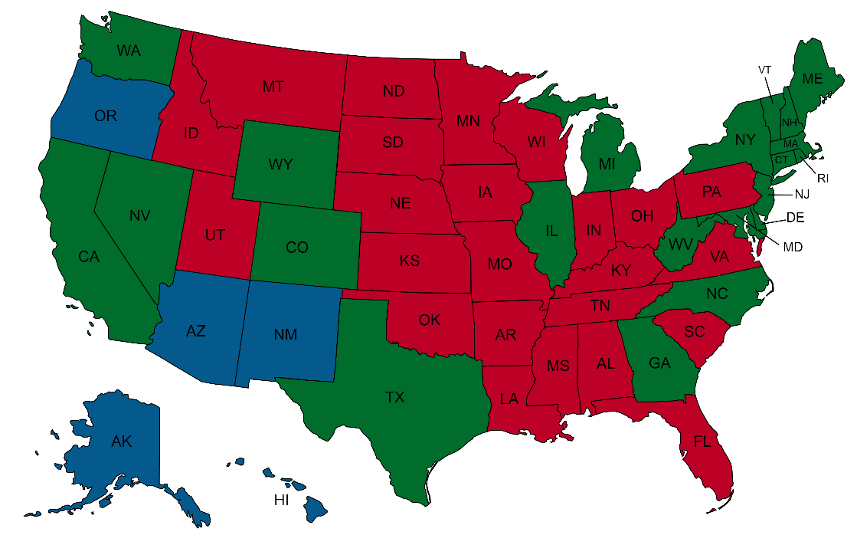
2022 vs. 2023 Foreign Ownership Laws
2022
2023

Slide 22
Alabama: HB 379 (Enacted)
Restricts “foreign principals” of “foreign country of concern” from acquiring agricultural land (includes forest property)
  Gov’t and political party of China, Iran, North Korea, or Russia (the “Big 4”)
“Purchase or other acquisition of title….”
  Leases?
“No title insurer, title agent, real estate licensee, or other settlement provider…shall be liable for any violations….”
Enforcement/penalty provisions?

Slide 23
Arkansas: SB 383 (Enacted)
Restricts “prohibited foreign party” (“PFP”) from acquiring “any interest” in ag land and forestland (excludes minerals)
  Individual, entity, and gov’t subject to International Traffic in Arms Regulations (“ITAR”)
  “Entities of particular concern” (as designated by U.S. SOS)
  Domestic/non-ITAR foreign entities if PFP has “significant interest or substantial control”
  Exempts “resident alien” (PFP that resides in AR)
  No express “grandfather clause”
  No research/experimentation exception
  Enforced by AG and “Office of Agricultural Intelligence”
  Judicial foreclosure
  Felony punishable by up to 2 years imprisonment and/or $15K fine
Restricts “PFP-controlled business” from acquiring public/private real estate
  PFPCB is PFP with a “controlling interest” (50% or more) in entity

Slide 24
Florida: SB 264 (Enacted)
Restricts “foreign principal” from “directly or indirectly owning, holding, or acquiring…any interest” in ag land and forestland
Individual, entity, and gov’t of “foreign country of concern” (i.e., Big 4)
Ag land violation enforced by FL Dep’t of Agriculture and Consumer Services
  Forfeiture
  Second-degree misdemeanor (up to 60 days in prison and/or $500 fine)
Restricts Chinese gov’t, Chinese entities, and individuals “domiciled in China” (not a citizen or lawful permanent resident of the U.S.) from acquiring real property
  Forfeiture
  Third-degree felony (up to 5 years in prison and/or $5K fine)
Criminal penalties for knowingly selling land to prohibited purchaser
Shen v. Simpson, No. 4:23-cv-208 (N.D. Fla. 2023)

Slide 25
Idaho: HB 173 (Enacted)
Restricts a foreign gov’t and state-controlled enterprise from acquiring/holding a “controlling interest” in ag land, water rights, mining claims, or mineral rights
  “Controlling interest” means: (1) > 50% ownership interest; or (2) < 50% but the gov’t directs the business affairs
  Express grandfather clause
  Exempts foreign pension funds
“Foreign government” is any gov’t that is not the U.S. federal gov’t or state gov’t
  Federally recognized Indian tribes?

Slide 26
Louisiana: HB 537 (Enacted)
Restricts “foreign adversary” from purchasing/leasing acquiring real property
Sellers can rescind a contract prior to the transfer of the property
Sellers/lessors are liable if aiding foreign adversary to acquire land
“No attorney, title insurer, title insurance producer, title insurance agency producer, lender, mortgage loan servicer, notary public, real estate agent, real estate broker, seller, or lessor shall have a duty to make any investigation…nor shall any person be liable for failing to identify” a foreign adversary
State AG authorized to enforce → court must order property be sold if violation
Rights in property are not void or voidable because property was held in violation
  Including mortgage, liens, security interests on the property

Slide 27
Montana: SB 203 (Enacted)
Restricts “foreign adversary” from buying/leasing ag land or entering into a contract which gives them control of ag land
  Must divest w/in 1 year
  If no divestment, state AG or county enforces → land sold at public auction

Slide 28
North Dakota: HB 1135; SB 2371 (Enacted)
HB 1135: Restrict foreign gov’t and gov’t-owned entities from holding any interest in ag land
  Exempts ag land used for research, development, and experimentation of ag inputs
  Up to 160 acres
SB 2371: Restricts gov’t and entities of a “foreign adversary” from acquiring real property
  Must divest w/in 3 years
  If they fail to divest, state’s attorney in the county where the property is located is authorized to bring a lawsuit for divestment
  If violation, the court must order divestment → must fully divest w/in 6 months
  If foreign owner fails to divest, the property is sold at a public sale and the foreign owner is subject to a civil penalty up to $25K

Slide 29
Ohio: HB 33 (Enacted)
Restricts certain foreign investors from acquiring ag land
  Ohio SOS compiles registry of prohibited purchasers based on different federal lists (“foreign adversary” list; terrorist exclusion list; international terrorism list)
Grandfather clause (cannot acquire additional land)
Exempts inheritance/security interest (must divest w/in 2 years)
May acquire up to 150 acres for non-ag purpose
SOS reports violations to state AG, who brings escheat action

Slide 30
Oklahoma: SB 212 (Enacted)
Amends FOL to restrict “alien or any person who is not a citizen” from acquiring title to land “either directly or indirectly through a business entity or trust….”
Restriction does not apply to entities “engaged in regulated interstate commerce in accordance with federal law”
  I.e., only restricts federal illegal activities, such as the production of marijuana
Deeds recorded must include affidavit that attests buyer is in compliance with the law

Slide 31
Tennessee: HB 40 (Enacted)
Restricts nonresident individuals, foreign business, or foreign gov’t of “sanctioned” countries from acquiring real property
  Sanctions program list (U.S. Treasury Dept.)
Exempts inheritance/security interest (must divest w/in 2 years)
All sanctioned investors must register landholdings with SOS
  Including landholdings before July 1, 2023
  $2K penalty
SOS reports potential violations to state AG → AG required to initiate an action
If violation, land escheats → public sale
No liability on real estate broker, attorney, title insurance company/agent
  BUT only those licensed in Tennessee!

Slide 32
Utah: HB 186 (Enacted)
Prohibits “restricted foreign entity” from acquiring real property
  Includes “agricultural land”; “waters of the state”
“Restricted foreign entity” includes an entity (and the gov’t of the country where the entity is organized/has PPOB) classified as a “military company” by the U.S. Dept. of Defense
Exempts land acquired before May 3, 2023
Exempts land acquired by inheritance, gift, donation, or grant after May 3, 2023 (must divest w/in 5 years)
  If failure to divest, the land escheats to the state
“A deed or other written instrument…purporting to convey an interest in land to a restricted foreign entity in violation” of the restriction is invalid

Slide 33
Virginia: SB 1438/HB 2325 (Enacted)
Restricts “foreign adversary” from obtaining ag land
Any acquisition in violation is void
  Title vests in state on date of FA acquisition (w/o payment)
  If transferred to non-FA, title vests in non-FA owner on date of FA acquisition
FA is barred from making claim for restitution of purchase price or any loss
City, county, town attorney, AG, or any non-FA person that was a party to a void transaction or subsequent holder of ag land by file an action:
  Eject FA from possession
  Quiet title
  Any other appropriate action to ratify the nullification of the transaction
Requires VA Dep’t of Agriculture and Consumer Services to publish annual report concerning foreign ownership of agricultural land and energy production

Slide 34


NALC Foreign Ownership Resources
Subscribe to The Feed using QR Code

