Slide 1


What’s In A Name? Current law & regulations governing “cell cultured meat”
The Nation’s Leading Source for Agricultural and Food Law Research and Information
THE NATIONAL AGRICULTURAL LAW CENTER
www.NationalAgLawCenter.org
(479) 575-7646 nataglaw@uark.edu
Notes:
Do they need to know your phone number?

Slide 2

Topic Areas
Federal oversight
Labeling laws
Pending lawsuits
Preemption

Slide 3
Federal Oversight: Generally Speaking
Who?
USDA
FSIS
What?
Food labels for meat and poultry products
Inspecting most meat, poultry, and processed egg products for safety, wholesomeness
Why?
Federal Meat Inspection Act
Egg Products Inspection Act
Poultry Products Inspection Act
Who?
HHS
What?
Food labels for all foods and food ingredients
Food safety oversight for products including:
Why?
Food, Drug, and Cosmetic Act
Except: meat and poultry products
FDA
Seafood, fish & shellfish products
Domestic and imported food sold in interstate commerce, including shell eggs but not meat and poultry
Food Safety Modernization Act

Slide 4
Why does it matter?
Example: Safety
Example: Labeling
FDA conducts inspections of food production establishments and warehouses and collects and analyzes samples for physical, chemical, and microbial contamination.
FSIS inspectors are physically present at all times a slaughter plant is in operation, and are present at least part of each day in establishments that further process meat and poultry products.
FDA does not pre-approve labels for food products
Instead, manufacturers are responsible for knowing and following current laws and regulations
FSIS must give prior approval for all labels used for meat and poultry products before those products may be marketed.

Slide 5
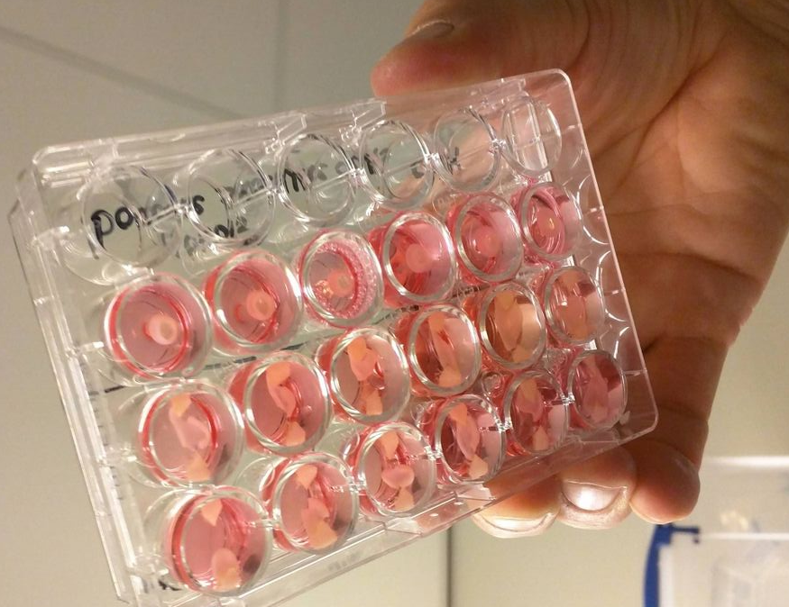
But what about:
“cell-cultured” meat?
“fake” meat?
“clean” meat?
“slaughter-free” meat?
“lab-produced” meat?
“human food produced using animal cell culture technology”?

Slide 6
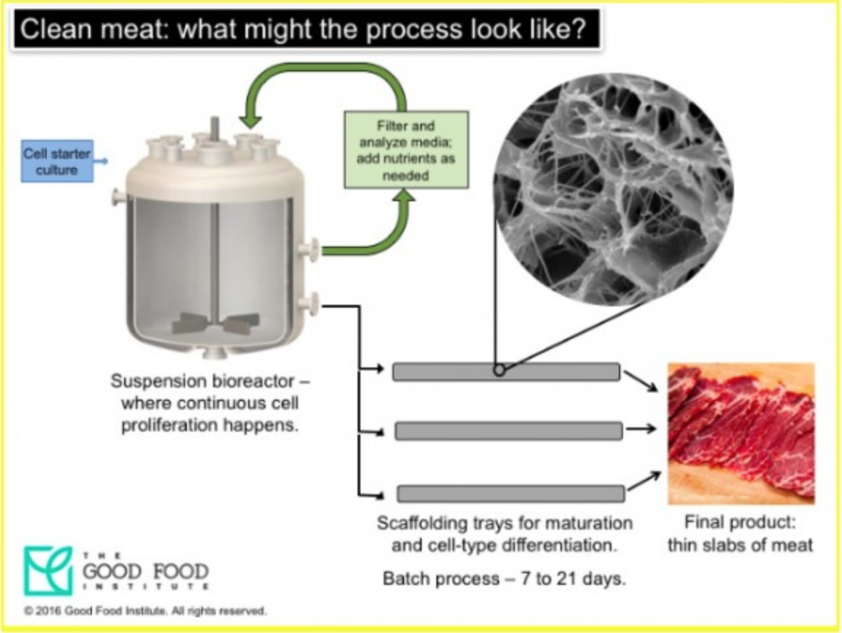
Process:
Stem cells are taken from the muscle of an animal
Stem cells or cell lines are combined with cell culture media (nutrients- amino acids and carbohydrates- salts, pH buffers, and growth factor) and left to multiply
Cells are moved to scaffolding trays, which support the cells, encouraging them to grow in organized patterns more similar to conventionally produced meat.
“Harvested”
The Good Food Institute at https://bit.ly/2SHlVyJ

Slide 7
Federal Oversight: Current Status
March 7, 2019: FDA/USDA MOU
In brief:
FDA will oversee the collection and growth of cultured cells.
“Oversee proliferation and differentiation of cells through the time of harvest, including by issuing regulations or guidance and conducting inspections, as appropriate.”
USDA will 1) oversee the processing of the cells into meat, and 2) be responsible for labeling
“Conduct inspection in establishments where cells cultured from livestock and poultry subject to the FMIA and PPIA are harvested, processed, packaged or labeled, in accordance with applicable FSIS regulations… to ensure that resulting products are safe, unadulterated, wholesome and properly labeled.”
“Require that the labeling of human food products derived from the cultured cells of livestock and poultry be preapproved and then verified through inspection, as required by FSIS regulations.”
https://bit.ly/2onsdqf

Slide 8
MOU Limitations
“This agreement represents the broad outline of the Parties’ present intent to collaborate in areas of mutual interest to HHS-FDA and USDA-FSIS.”
Perdue: “if the regulatory framework is finalized in 2019, ‘that’d probably be pretty fast for federal agencies.’”
The New Food Economy, Dispatch from D.C., 10-25-18, https://bit.ly/2pH4lig

Slide 9
Federal Oversight: Pending Bills
SB 1056- proposed April 4, 2019 by Sen. Hyde-Smith
Requires USDA/FDA to have specific responsibilities in regard to the food safety and labeling aspects of cell-cultured meat.
Requires binding formal agreement between agencies
Specific amendments to FMIA and PPIA to include these types of products
Status: Referred to ag committee.
https://bit.ly/2Wdq25B

Slide 10
Federal Oversight: Pending Bills
“Food Safety Modernization for Innovative Technologies Act”
Senate: S. 3053 (https://bit.ly/2HznFU7)
House of Representatives: H.R. 5728 (https://bit.ly/2P4wk50)
Very similar division of labor to that found in MOU
Joint agency jurisdiction over food intended for humans that is produced using animal cell culture technology.
FDA responsible for tissue collection, cell lines, and cell banks
FDA responsible for food derived from cell lines of animals other than livestock or poultry
USDA responsible for food derived from cell lines of livestock and poultry
“livestock”: cattle, sheep, swine, goats, and fish of the order Siluriformes; and
“poultry”: means any domesticated bird, whether live or dead.
Status:
S. 3053 introduced on 12/16/2019
Referred to the Committee on Agriculture, Nutrition, and Forestry.
H.R. 5728 introduced on 01/30/2020
Referred to the House committees on agriculture and energy and commerce.

Slide 11
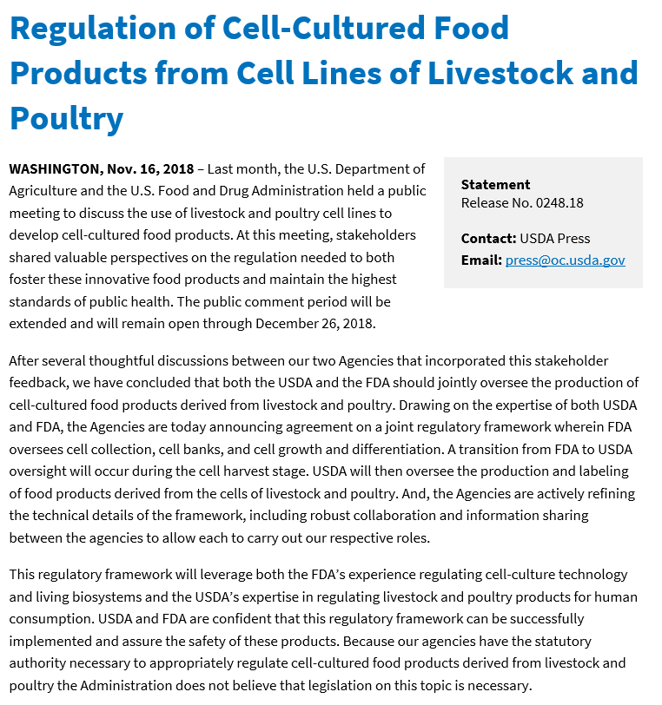
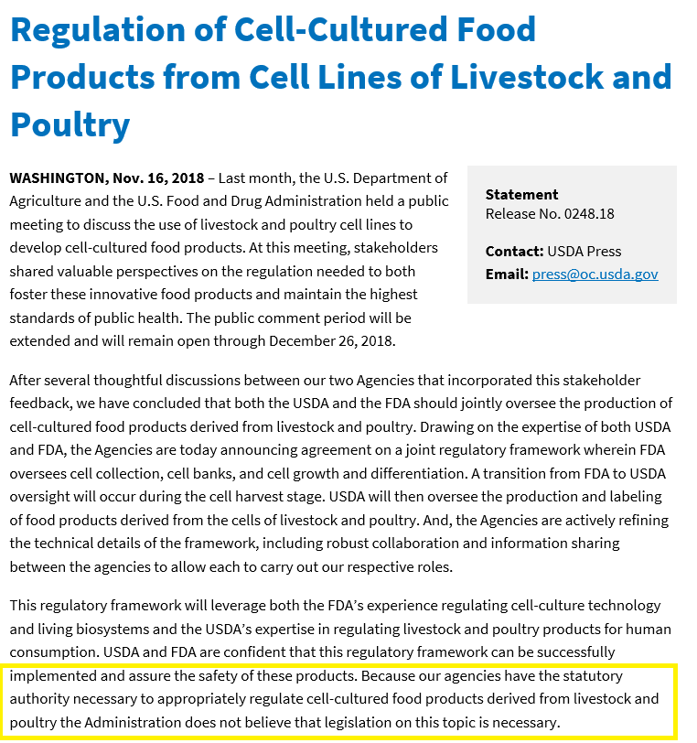
Administration Position:

Slide 12
Federal Oversight: Pending Standards Petition
2/18: US Cattlemen’s association
Petition to prohibit the use of the term “beef” and “meat” for products not derived from animals that have been slaughtered or butchered.
“Specifically, FSIS should require that any product labeled as “beef” come from cattle that have been born, raised, and harvested in the traditional manner, rather than coming from alternative sources such as a synthetic product from plant, insects, or other non-animal components and any product grown in labs from animal cells.”
Definitions added to FSIS Food Standards and Labeling Policy Book
Still pending
6173 comments received
https://bit.ly/326WUQp

Slide 13
Federal Oversight: Pending Bills
“Real Marketing Edible Artificials Truthfully Act of 2019”
Senate: S. 3016 (https://bit.ly/39Kt075)
House of Representatives: H.R. 4881 (https://bit.ly/2wuHdXF)
Proposal:
“Codify the definition of beef for labeling purposes”
‘Beef’ or ‘beef product’ means any product containing edible meat tissue harvested in whole form from domesticated Bos indicus or Bos taurus cattle.
‘Imitation meat food product’ is any product manufactured to appear as a meat food product or any food product which approximates the aesthetic qualities (primarily texture, flavor, and appearance) and/or chemical characteristics of specific types of meat but does not contain any meat, meat food product, or meat byproduct ingredients.
‘Meat’ & ‘meat food product’ has meaning given in Federal Meat Inspection Act.
“Reinforce existing misbranding provisions to eliminate consumer confusion”
“any imitation meat food product, beef, or beef product shall be deemed to be misbranded unless its label bears, in type of uniform size and prominence, the word ‘imitation’ immediately before or after the name of the food and a statement that clearly indicates the product is not derived from or does not contain meat.”
“Enhance enforcement measures available to the USDA if the FDA fails to take appropriate action” (30 day limit on initiation)
Each finding of misbranding is a separate offense.
Status:
S. 3016 introduced on 12/11/2019
Referred to the Committee on Health, Education, Labor and Pensions
H.R. 4881 introduced on 10/28/19
Referred to the Subcommittee on Livestock and Foreign Agriculture

Slide 14
Topic Areas
Federal oversight
Labeling
Pending lawsuits
Preemption

Slide 15
Mo Rev. Stat. 265.494
“Prohibited practices, required disclosures. —
No person advertising, offering for sale or selling all or part of a carcass or food plan shall engage in any misleading or deceptive practices, including, but not limited to, any one or more of the following:
…(7) Misrepresenting the cut, grade, brand or trade name, or weight or measure of any product, or misrepresenting a product as meat that is not derived from harvested production livestock or poultry”

Slide 16
Examples
Alabama
Meat is not: a food product that contains cultured animal tissue produced from animal cell cultures outside of the organism from which it is derived
South Dakota
Meat food product: any product capable of use as human food which is made wholly or in part from any meat or other portion of the carcass of any cattle, bison, sheep, swine, goats, equine, ratites, captive cervidae, and other species...excepting products which contain meat or other portions of such carcasses only in a relatively small proportion
Arkansas
Beef: the flesh of domesticated cow or steer
Meat by-product: edible part other than meat which has been derived from one or more cattle, bison, sheep, swine, goats, equine, ratites, captive cervidae, and other species
Poultry: anything containing meat intended for or capable of use for human consumption, that is derived, in whole or in part, from any domesticated bird intended for human consumption.
Meat: an portion of livestock, poultry, or cervid carcass that is edible by humans
Pork: flesh of domesticate swine
Rice: whole, broken, or ground kernels of two species and wild rice
Utilizing a term that is similar or the same to a term that has been used or defined historically in reference to a specific agricultural product

Slide 17
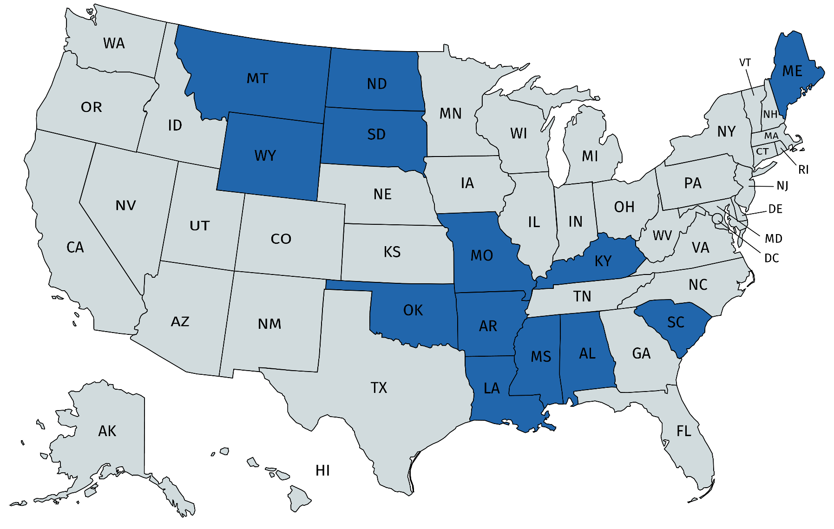
Passed Statutes

Slide 18
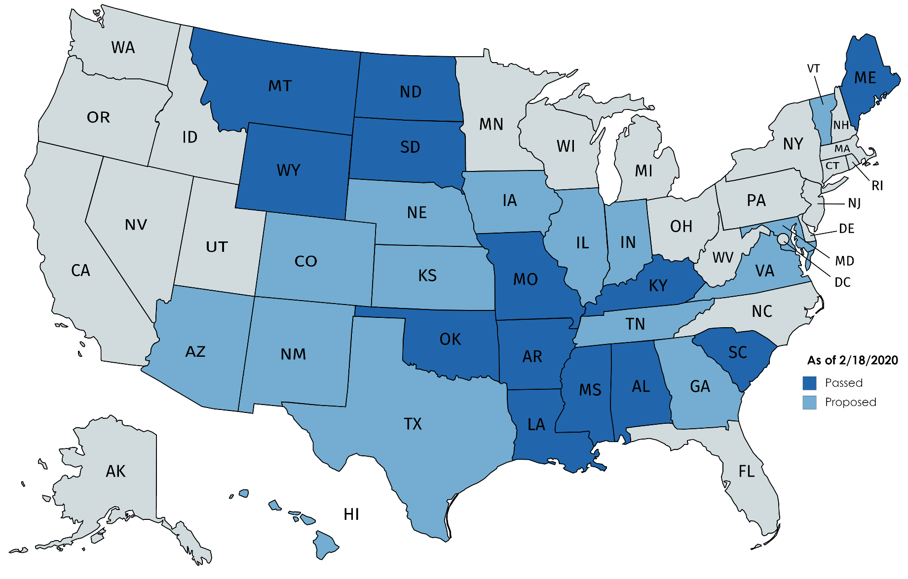
Introduced Statutes

Slide 19
Most Recent Proposals
Maryland (SB 188)
Kansas (HB 2437)
A food shall be deemed to be misbranded if… it is offered for sale in the state with a label that identifies the product as a meat or a meat product and the product
Contains animal tissue cultured from animal cells outside the animal from which the tissue is derived or
Is made from plants or insects
Status:
Introduced 1/15/20
Hearing 2/6/20
Unfavorable committee report 2/17/20
Definitions:
"Meat analog" means any food that approximates the aesthetic qualities, primarily texture, flavor and appearance, or the chemical characteristics of any specific type of meat, meat food product, poultry product or poultry food product, but does not contain any meat, meat food product, poultry product or poultry food product.
"Identifiable meat term" includes, but is not limited to, terms such as meat, beef, pork, poultry, chicken, turkey, lamb, goat, jerky, steak, hamburger, burger, ribs, roast, bacon, bratwurst, hot dog, ham, sausage, tenderloin, wings, breast and other terms for food that contain any meat, meat food product, poultry product or poultry food product.
If it is a meat analog AND its labeling utilizes an identifiable meat term;
IT MUST INCLUDE a disclaimer in the same font, style and size, immediately before or after the identifiable meat term, stating one of the following: (A) "This product does not contain meat"; (B) "meatless"; or (C) "meatfree.“
If not, it shall be deemed misbranded
Status:
Introduced 1/13/20
Hearing 1/23/20
Committee report recommending bill be passed as amended 2/6/20

Slide 20
Topic Areas
Federal oversight
Labeling Laws
Pending lawsuits
Preemption

Slide 21
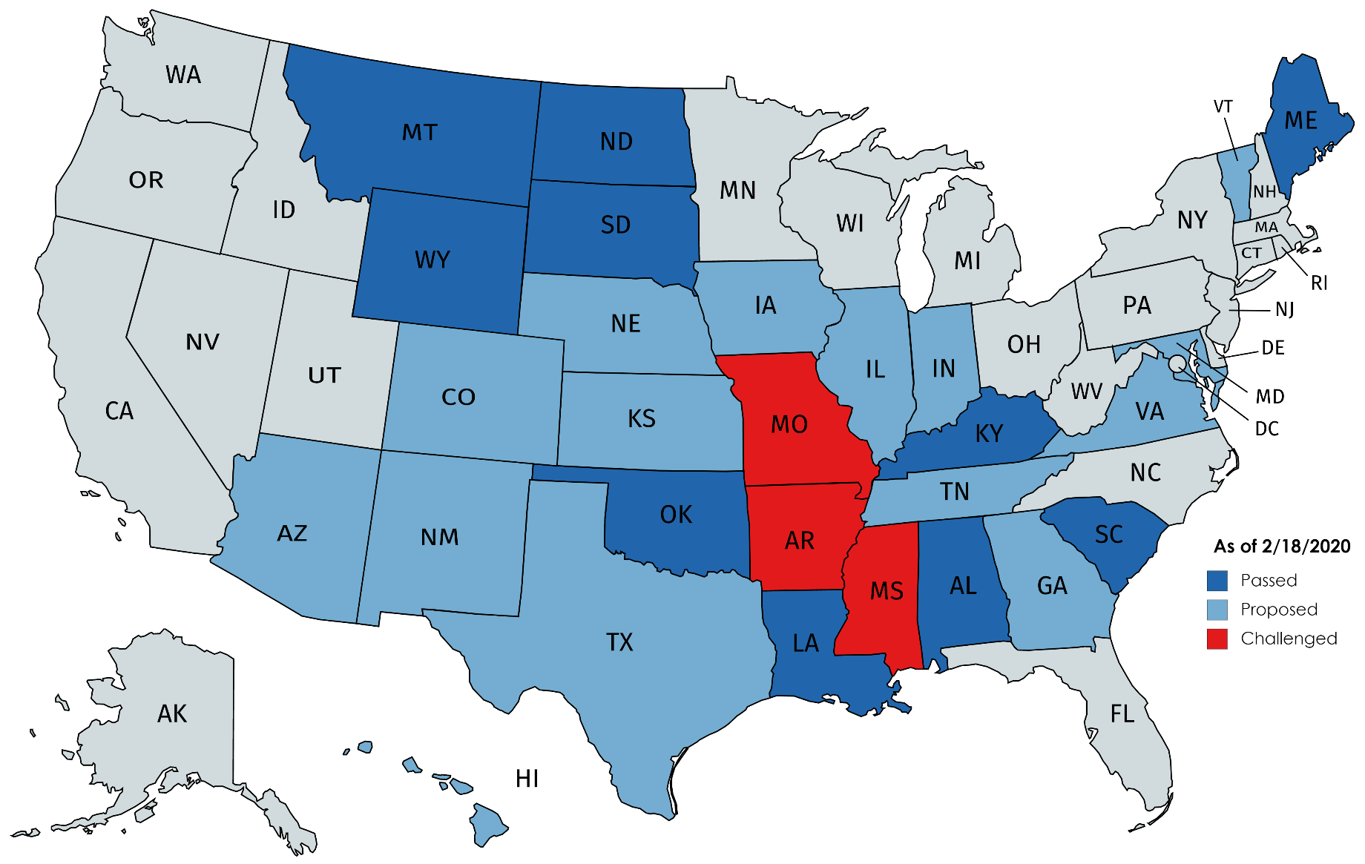
Challenged Statutes

Slide 22
Mo Rev. Stat. 265.494
“Prohibited practices, required disclosures. —
No person advertising, offering for sale or selling all or part of a carcass or food plan shall engage in any misleading or deceptive practices, including, but not limited to, any one or more of the following:
…(7) Misrepresenting the cut, grade, brand or trade name, or weight or measure of any product, or misrepresenting a product as meat that is not derived from harvested production livestock or poultry”

Slide 23
Turtle Island Foods, SPC v. Richardson, No. 2:18-CV-04173
Mo Rev. Stat. 265.494 became effective Aug 28, 2018.
Guidance from MO Dept of Ag: “MDA will not refer products whose labels contain the following:
Prominent statement on the front of the package, immediately before or immediately after the product name, that the product is “plant-based,” “veggie,” “lab-grown,” “lab-created,” or a comparable qualifier; and
Prominent statement on the package that the product is “made from plants,” “grown in a lab,” or a comparable disclosure.”
Lawsuit filed Aug 29, 2018.
1st amendment claims
Sept 2019:
W.D.Mo. Judge denied the plaintiffs' motion for a preliminary injunction to enjoin enforcement of the labeling law.
No credible risk of prosecution because it complies with guidance
Certified defendant class for all of Missouri's 115 prosecuting attorneys in their official capacity who might enforce the law.
Plaintiffs requested interlocutory appeal to 8th Circuit (denied), and is now back with District Court and ordered to submit proposal for scheduling orders

Slide 24
MS Code 75-35-15
No item or product subject to this article shall be sold or offered for sale by any person, firm, or corporation, under any name or other marking or labeling which is false or misleading, or in any container of a misleading form or size, but established trade names and other marking and labeling and containers which are not false or misleading and which are approved by the commissioner, are permitted. A food product that contains cultured animal tissue produced from animal cell cultures outside of the organism from which it is derived shall not be labeled as meat or a meat food product. A plant-based or insect-based food product shall not be labeled as meat or a meat food product.

Slide 25
Upton’s Naturals Co et al v. Phil Bryant, No. 3:19-CV-00462
MS Code §75-35-15 took effect July 1, 2019
Lawsuit/challenge to code filed same day (1st amd)
Regs proposed the same day.
New regs proposed Sept 5
Meat alternatives that use meat words on the packaging won’t be considered false or misleading if they contain at least one qualifier including “meatless,” “meat-free,” “plant-based,” “vegetarian,” “insect-based,” “lab-grown”
Comment period closed Sept 30.
Oct 7:
Insect based alternatives regs finalized, effective 11/7/19
https://bit.ly/33TmBUi
Plant based alternatives regs finalized, effective 11/7/19
https://bit.ly/32HHJwH
Cell based alternatives regs have not been finalized
https://bit.ly/2mFgOBK
Lawsuit dismissed Nov. 7, 2019

Slide 26
Ark. Code Ann §2-1-301 through §2-1-306
Effective 7/24/19 (https://bit.ly/2SDUKop)
Required definitions:
Beef: an agricultural product derived from a domesticated bovine
Meat: an agricultural product derived from harvested livestock, poultry or cervids
Does not include a
Synthetic product derived from a plant, insect or other source, or
Product grown in a laboratory from animal cells
Pork: an agricultural product derived from a domesticated swine
Rice: whole, broken, or ground kernels of two species and wild rice
Prohibitions:
Utilizing a term that is the same as or similar to a term that has been used or defined historically in reference to a specific agricultural product
Affixing a label that uses a variation of rice in the name of the agricultural product when the agricultural product is not rice or derived from rice.
Penalty: up to $1k/violation, each item is a separate violation

Slide 27
Turtle Foods v. Soman 4:19-CV-514-KGB
Complaint filed 7/22/19
Grounds: 1st amd/vague/dormant commerce clause
https://bit.ly/33Tq8lu
Code became effective 7/24/19
https://bit.ly/2Ojm4Et
Motion for preliminary injunction held 10/7/19
Preliminary injunction granted on 12/11/19
Initial scheduling for conference/trial

Slide 28
Topic Areas
Federal oversight
Labeling Laws
Pending lawsuits
Preemption

Slide 29
Preemption
Supremacy Clause: “the Laws of the United States . . . shall be the supreme Law of the Land; and the Judges in every State shall be bound thereby, any Thing in the Constitution or Laws of any State to the Contrary notwithstanding.”
Effect: Federal law supersedes/preempts conflicting state laws
Types of preemption:
Express preemption- federal law expressly states that it is intended to preempt state law
Field preemption- when the federal law is so broad it leaves no room for a state to regulate
Conflict preemption- when compliance with both federal and state regulations is impossible
Useful resource: Federal Preemption: A Legal Primer, Congressional Research Service R45825

Slide 30
FMIA/PPIA
Federal Meat Inspection Act
“Marking, labeling, packaging, or ingredient requirements in addition to, or different than, those made under this chapter may not be imposed by any State…”
21 U.S.C. § 678
Poultry Products Inspection Act
“Marking, labeling, packaging, or ingredient requirements (or storage or handling requirements found by the Secretary to unduly interfere with the free flow of poultry products in commerce) in addition to, or different than, those made under this chapter may not be imposed by any State…
21 U.S. Code § 467e

Slide 31
FDCA
Food, Drug and Cosmetic Act:
“no State or political subdivision of a State may directly or indirectly establish under any authority or continue in effect as to any food in interstate commerce ... any requirement for the labeling of food of the type required by” nearly every subsection of Section 343 “that is not identical to the requirement of such section.”
21 U.S.C. § 343-1(a)(1)–(5)

Slide 32
Preemption in Practice
USDA
Responsibility: Cell-cultured livestock/poultry/catfish products after harvest, including labeling.
Fairly clear express preemption of state laws through the FMIA/PPIA language
FDA
Responsibility: Cell-cultured seafood/plant based products throughout production cycle, including labeling
Probably more a question of whether it falls under field preemption or is in direct conflict with a federal requirement.

Slide 33
Kansas (HB 2437)
(m) If it is a meat analog and: (1) Its labeling or advertisement utilizes an identifiable meat term; and (2) the labeling or advertisement does not have a disclaimer in the same font, style and size, immediately before or after the identifiable meat term, stating one of the following: (A) "This product does not contain meat"; (B) "meatless"; or (C) "meatfree.“ The provisions of this subsection shall not apply to a menu or menu board or to food that can be defined as "imitation" under subsection (c) and is in compliance with the provisions of such subsection.
(n) If any provision of this section is held to be invalid or unconstitutional, it shall be conclusively presumed that the legislature would have enacted the remainder of this section without such invalid or unconstitutional provision.

Slide 34
Kansas (HB 2437)
(m) If it is a meat analog and: (1) Its labeling or advertisement utilizes an identifiable meat term; and (2) the labeling or advertisement does not have a disclaimer in the same font, style and size, immediately before or after the identifiable meat term, stating one of the following: (A) "This product does not contain meat"; (B) "meatless"; or (C) "meatfree.“ The provisions of this subsection shall not apply to a menu or menu board or to food that can be defined as "imitation" under subsection (c) and is in compliance with the provisions of such subsection.
(n) If any provision of this section is held to be invalid or unconstitutional, it shall be conclusively presumed that the legislature would have enacted the remainder of this section without such invalid or unconstitutional provision.

Slide 35
Introduced Statutes since 2018

Slide 36

Contact Information:
The Nation’s Leading Source for Agricultural and Food Law Research and Information
THE NATIONAL AGRICULTURAL LAW CENTER
Elizabeth Rumley
Phone: (479) 575-7646
Email: erumley@uark.edu
www.nationalaglawcenter.org

